Slide 1

CompSci 471
Artificial Intelligence
Lesson 5: Uninformed Search
Same map, different frontier, different behavior
D
A
2
1
5
8
S
4
B
1
E
2
G
2
3
6
C
2
F
Start
Frontier
Expand
Goal
Search is systematic exploration controlled by a selection rule.
Fall 2026
Notes:
Open by connecting Lesson 4 formulation to the need for a search procedure. Emphasize that this lesson is about how the frontier controls the next state to expand.

Slide 2
Retrieval warm-up
Lesson 4 gave the search algorithm a problem representation.
We have:
Start state
Actions
Goal test
Path costs
What information is still missing before the system can find a solution?
Question 1
Question 2
Question 3
Question 4
Which state is examined next?
What gets remembered?
When do we stop?
How do we reconstruct the path?
CS 471 | L05: Uninformed Search
2
Notes:
Have students infer that after formulation we need a systematic exploration procedure. The key missing idea is frontier management.

Slide 3
Today’s mission
By the end of Lesson 5, students should be able to…
1
Describe how DFS, BFS, and UCS explore state spaces
2
Compare search strategies based on completeness and optimality
3
Explain how frontier management affects algorithm behavior
Performance target: trace a small search, identify the next node, and justify the algorithm choice.
CS 471 | L05: Uninformed Search
3
Notes:
Tie directly to the lesson objectives and assessment expectations. Students should understand both execution and comparison.

Slide 4
Running scenario: relay recovery
The rover must reach a failed communications relay through waypoint routes.
Mission setup
D
Start: S
A
2
8
Goal relay: G
1
5
S
4
B
1
E
2
G
Edge labels: energy cost
2
3
6
Ties: break alphabetically
C
2
F
Same graph, three search behaviors
Should the rover prefer fewer moves or lower energy?
CS 471 | L05: Uninformed Search
4
Notes:
Introduce a single graph that will be used throughout the lesson. Students should see that the objective and frontier rule can change the selected route.

Slide 5
What is a search node?
A node stores enough information to recover how a state was reached.
Part
Purpose
State vs. node
State
current situation
State: one situation in the problem.
Search node: a record of one path that reaches that state.
The same state can appear through different paths with different costs.
Parent
previous node
Action
move from parent
Depth
number of actions
g(n)
cost from start
CS 471 | L05: Uninformed Search
6
Notes:
This supports later tracing and code interpretation. Do not overcomplicate tree-search versus graph-search; focus on path reconstruction and accumulated cost.

Slide 6
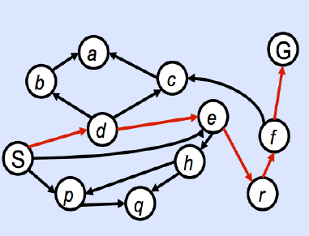
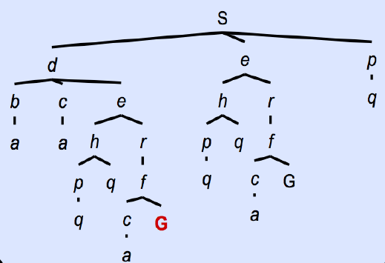
State space, search tree, repeated states
One situation may be reached through several paths.
State space
Search tree
An explored set helps prevent cycles and repeated expansion.
For UCS, a cheaper path may need to replace a more expensive one.
CS 471 | L05: Uninformed Search
7
Notes:
Photos from Berkeley CS188 notes. Students should understand that duplicate states and cycles affect behavior. This prepares them for UCS update rules without requiring full pseudocode.

Slide 7
Search is repeated selection
Most search algorithms share the same basic loop.
1
2
3
4
5
Put start on frontier
Select one frontier node
Test for goal
Expand successors
Update frontier
The algorithm changes when the selection rule changes.
Frontier
Select
Goal test
Expand
Update
CS 471 | L05: Uninformed Search
5
Notes:
Keep this loop visible conceptually throughout the lesson. The pop/select operation is where BFS, DFS, and UCS diverge.

Slide 8
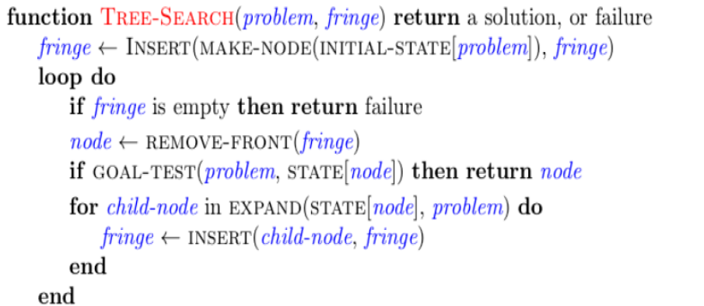
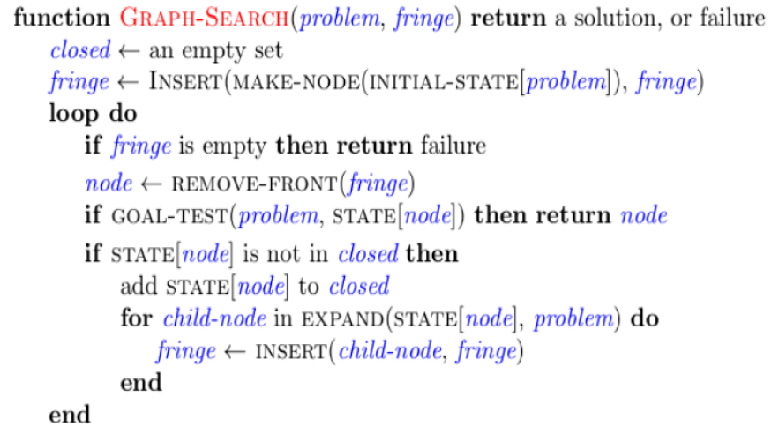
Search pseudo-algorithms
Maintaining a fringe/frontier is the key
closed aka expanded
Frontier
Select
Goal test
Expand
Update
CS 471 | L05: Uninformed Search
7
Notes:
Photos from Berkeley CS188 notes. Students should understand that the modified algorithm to the right prevents expensive computation due to cycles or infinite branches.

Slide 9
(aka fringe)
The frontier controls the algorithm
The search loop stays similar; the frontier rule changes behavior.
Algorithm
Frontier structure
Select next
BFS
Queue
oldest / shallowest
DFS
Stack
newest / deepest
UCS
Priority queue
lowest g(n)
Same graph. Same goal. Different frontier. Different expansion order.
CS 471 | L05: Uninformed Search
8
Notes:
This is the conceptual heart of the lesson. Students should see BFS, DFS, and UCS as variants of the same general process.

Slide 10
Algorithms can be compared
How to determine which algorithm is best for a problem
Property
Definition
Completeness
If there exists a solution to the search problem, is the
strategy guaranteed to find it given infinite computational resources?
Optimality
Is the strategy guaranteed to find the lowest cost path to a
goal state?
Memory Use
How much memory is needed to store the searched nodes?
Appropriate Use
In what case should the algorithm be used?
CS 471 | L05: Uninformed Search
8

Slide 11
Breadth-First Search: explore by layers
BFS expands the shallowest available node first.
D
Frontier behavior
A
F
Queue
first in, first out
S
B
E
G
C
F
BFS does not know edge costs unless every step cost is effectively equal.
CS 471 | L05: Uninformed Search
9
Notes:
Define BFS and emphasize shallowest/layered exploration. Clarify that shallowest only means fewest steps, not least total cost when edge costs differ.

Slide 12
BFS queue mechanics
The oldest frontier node is expanded next.
Remove here
Add new successors here
A
B
C
D
E
Example update:
Pop A → add D, E → frontier becomes [B, C, D, E]
Frontier
Select
Goal test
Expand
Update
CS 471 | L05: Uninformed Search
10
Notes:
Students often trace correctly only after seeing the physical queue mechanics. Reinforce that successor ordering matters for deterministic traces.

Slide 13
Guided BFS trace
Track expansion order, frontier, and returned path separately.
Step
Expanded
Frontier
0
—
[(S)]
D
A
D
A
2
2
1
S
[(S,A), (S,B), (S,C)]
8
1
8
1
5
5
S
S
B
B
E
E
G
4
G
2
A
[(S,B), (S,C), (S,A,D), (S,A,E)]
4
1
1
2
2
2
2
3
3
6
6
C
3
B
[(S,C), (S,A,D), (S,A,E), (S,B,E), (S,B,F)]
C
F
2
F
2
...
partner
complete …
Do not confuse expanded order, frontier contents, and solution path.
CS 471 | L05: Uninformed Search
11
Notes:
Trace the first rows together, then have pairs complete one or two rows. Keep the graph simpler by hiding costs because BFS is not using them.

Slide 14
What BFS guarantees
BFS is strongest when every action has the same cost.
Complete?
Optimal?
Yes, with finite branching (i.e., a solution exists)
No, unless all edge costs are equal
Memory
Best use
Often high: stores a full frontier layer (O(b^{s}))
fewest actions, shallow goals
Key misconception: shallowest does not necessarily mean cheapest.
CS 471 | L05: Uninformed Search
12
Notes:
Connect to assessment language: completeness, optimality, memory use, and appropriate use. Make the conditions visible.

Slide 15
Depth-First Search: follow one branch
DFS expands the most recently added frontier node.
Frontier behavior
A
D
Stack
last in, first out
F
S
B
E
G
DFS can reach a solution quickly, but it may commit to a poor branch first.
C
F
CS 471 | L05: Uninformed Search
13
Notes:
Emphasize that DFS is branch-first and uses the newest node. Use highlighted path to show how it may quickly go deep.

Slide 16
DFS stack mechanics
The newest frontier node is expanded next.
Top of stack
Successor-order convention
C
If successors are placed on the frontier alphabetically, DFS removes the most recently added one.
That can make the last alphabetical successor expand first.
B
A
LIFO is simple; tracing it consistently is the hard part.
CS 471 | L05: Uninformed Search
14
Notes:
This addresses a common tracing error: students may know LIFO but mishandle successor ordering. Align with the course convention of alphabetical ties.

Slide 17
Guided DFS trace
Use the same graph; only the frontier rule changes.
Step
Expanded
Frontier
0
—
[(S)]
D
A
D
A
2
2
1
S
[(S,A), (S,B), (S,C)]
8
1
5
8
1
5
S
B
E
G
S
4
B
1
E
2
G
2
C
[(S,A), (S,B), (S,C,F)]
4
1
2
2
2
3
6
3
6
…
partner
complete …
C
C
F
2
F
2
With this ordering, DFS returns the first deep solution it finds.
CS 471 | L05: Uninformed Search
15
Notes:
Walk through the deterministic DFS trace. Explain that different successor ordering could produce different DFS behavior, which is why we state the convention.

Slide 18
What DFS guarantees
DFS trades weaker guarantees for lower memory.
Complete?
Optimal?
Not guaranteed with cycles or infinite depth
No (it will find the leftmost solution without regard for path coses)
Memory
Best use
Often low: stores a branch and alternatives, so O(bm)
deep search when any solution is acceptable
DFS is not “bad BFS.” It is a different tradeoff.
CS 471 | L05: Uninformed Search
16
Notes:
Compare with BFS. Emphasize the memory advantage and the lack of optimality. Ask whether DFS is appropriate for a safety-critical least-cost route.

Slide 19
Uniform-Cost Search: follow accumulated cost
UCS expands the frontier node with the smallest path cost g(n).
What UCS knows
A
2
D
g(n) = cost already accumulated
from the start to node n
1
5
8
S
4
B
1
E
2
G
2
3
6
UCS is still uninformed: it does not estimate the remaining cost to the goal.
C
2
F
CS 471 | L05: Uninformed Search
17
Notes:
Introduce g(n). This creates the bridge to Lesson 6, where heuristics estimate remaining cost.

Slide 20
UCS priority-queue mechanics
The frontier is ordered by lowest accumulated path cost.
Node
g(n)
A
4
UCS selects B
B
2
because g(B) is smallest
C
7
Not oldest. Not shallowest. Not closest-looking. Lowest accumulated cost.
CS 471 | L05: Uninformed Search
18
Notes:
Use this simple table before the graph trace. It helps students distinguish UCS from BFS and DFS.

Slide 21
A cheaper path can replace an expensive one
UCS must keep the best known path to a frontier state.
First path to E
Later path to E
S → A → E
g(E) = 6
S → B → E
g(E) = 5
Update E: lower cost changes its priority and parent path.
CS 471 | L05: Uninformed Search
19
Notes:
Explain frontier update behavior. This is crucial for executing UCS correctly and for understanding why UCS finds least-cost paths.

Slide 22
Guided UCS trace
List expansion order, frontier updates, final path, and total cost.
Step
Expanded
Frontier after update
0
—
[((S), 0)]
D
A
D
A
2
2
1
S
[((S,A),1), ((S,C),2), ((S,B),4)]
8
1
5
8
1
5
S
B
E
G
S
4
B
1
E
2
G
2
A
[((S,C),2), ((S,A,D),3), ((S,B),4), ((S,A,E),6)]
4
1
2
2
2
3
6
3
6
C
3
C
[((S,A,D),3), ((S,B),4), ((S,C,F),4), ((S,A,E),6)]
C
F
2
F
2
...
partner
finish trace
Goal rule: return G when it is removed as the lowest-cost frontier node.
CS 471 | L05: Uninformed Search
20
Notes:
Have students complete the remaining UCS trace. Emphasize the standard exam expectations: expansion order, frontier updates, final path, total cost.
[((S),0)]
[((S,A),1), ((S,C),2), ((S,B),4)]
[((S,C),2), ((S,A,D),3), ((S,B),4), ((S,A,E),6)]
[((S,A,D),3), ((S,B,4), ((S,C,F),4), ((S,A,E),6)]
[((S,B),4), ((S,C,F),4), ((S,A,E),6), ((S,A,D,G),11)]
[((S,C,F),4), ((S,B,E),5), ((S,A,E),6), ((S,B,F,7), ((S,A,D,G),11)]
[((S,B,E),5), ((S,A,E),6), ((S,B,F,7), ((S,C,F,G),10), ((S,A,D,G),11)]
[ ((S,A,E),6), ((S,B,F,7), ((S,B,E,G),7), ((S,C,F,G),10), ((S,A,D,G),11)]
[((S,B,F,7), ((S,B,E,G),7), ((S,A,E,G),8), ((S,C,F,G),10), ((S,A,D,G),11)]
[((S,B,E,G),7), ((S,A,E,G),8), ((S,C,F,G),10), ((S,A,D,G),11), ((S,B,F,G,13)]
((S,B,E,G),7)

Slide 23
What UCS guarantees
UCS is designed for least-cost solutions.
Complete?
Optimal?
Yes, with positive edge costs and finite branching
Yes, least total path cost (assume all nonnegative edge costs)
Memory
Best use
Potentially high, dependent on number of nodes at level of cheapest solution
varying route costs; cost matters
UCS may take more steps if doing so reduces total cost.
CS 471 | L05: Uninformed Search
21
Notes:
Summarize UCS properties and contrast with BFS. Reinforce positive step costs and the least-cost goal acceptance rule.

Slide 24
Same graph, three behaviors
The frontier rule changes the expansion order and returned route.
Algorithm
Explores
Likely return
Tradeoff
BFS
layer by layer
fewest actions
may ignore cost
DFS
branch by branch
first deep solution
low memory, no optimality
UCS
cost by cost
least path cost
uses g(n)
The problem did not change. The frontier did.
That is why frontier management is algorithm behavior.
CS 471 | L05: Uninformed Search
22
Notes:
This is the major synthesis before students move to selection and diagnosis tasks.

Slide 25
Completeness, optimality, and memory
Guarantees depend on assumptions.
Algorithm
Selection rule
Complete?
Optimal?
Memory
BFS
shallowest
yes, finite branching
only w/equal step costs
high
DFS
newest / deepest
not guaranteed
no
low
UCS
lowest g(n)
yes, positive costs
yes, nonnegative costs
potentially high
Do not memorize guarantees without their conditions.
CS 471 | L05: Uninformed Search
23
Notes:
This directly supports GR-style comparison and quiz-style true/false properties. Emphasize the conditions attached to each guarantee.

Slide 26
Choose the algorithm
Match the problem objective to the frontier rule.
Fewest actions
Memory limited
Least cost
Every repair action takes one hour; minimize number of repairs.
A deep configuration may work; any solution is acceptable.
Routes have different fuel costs; minimize total fuel.
BFS
DFS
UCS
Justification matters: name the property that makes the algorithm fit.
CS 471 | L05: Uninformed Search
24
Notes:
Use as quick formative practice. Have students give one-sentence justifications, not just algorithm names.

Slide 27
Diagnose the frontier
Data structure reveals search behavior.
Queue
Stack
Priority queue
[A, B, C]
select A
top: C, B, A
select C
A:5, B:2, C:4
select B
BFS
DFS
UCS
Code interpretation: same loop, different frontier type.
CS 471 | L05: Uninformed Search
25
Notes:
This supports code interpretation and quick next-node questions. Ask students to identify the algorithm from frontier behavior.

Slide 28
Exit Ticket
Rebuild the search comparison from memory.
Complete
Apply
BFS → ______ → shallowest
DFS → ______ → newest/deepest
UCS → ______ → lowest g(n)
Frontier snapshot:
A: depth 1, g=5, added first
B: depth 2, g=2, added second
C: depth 1, g=4, added third
Which node does BFS select? DFS? UCS?
The frontier determines which node is expanded next.
Next class: Informed Search — what changes when the system has an estimate of what remains?
CS 471 | L05: Uninformed Search
27
Notes:
Collect as an exit ticket or use for rapid retrieval at the start of Lesson 6. Expected: queue, stack, priority queue. BFS selects A, DFS selects C, UCS selects B.

